Slide 1
COMP 2230
Week 14 - Monday

Slide 2
Last time
More on finite-state automata
Simplifying finite-state automata

Slide 3
Questions?

Slide 4
Assignment 6

Slide 5
Logical warmup
If three cats catch three rats in three minutes, how many cats will catch 100 rats in 100 minutes?

Slide 6
Simplifying FSAs

Slide 7
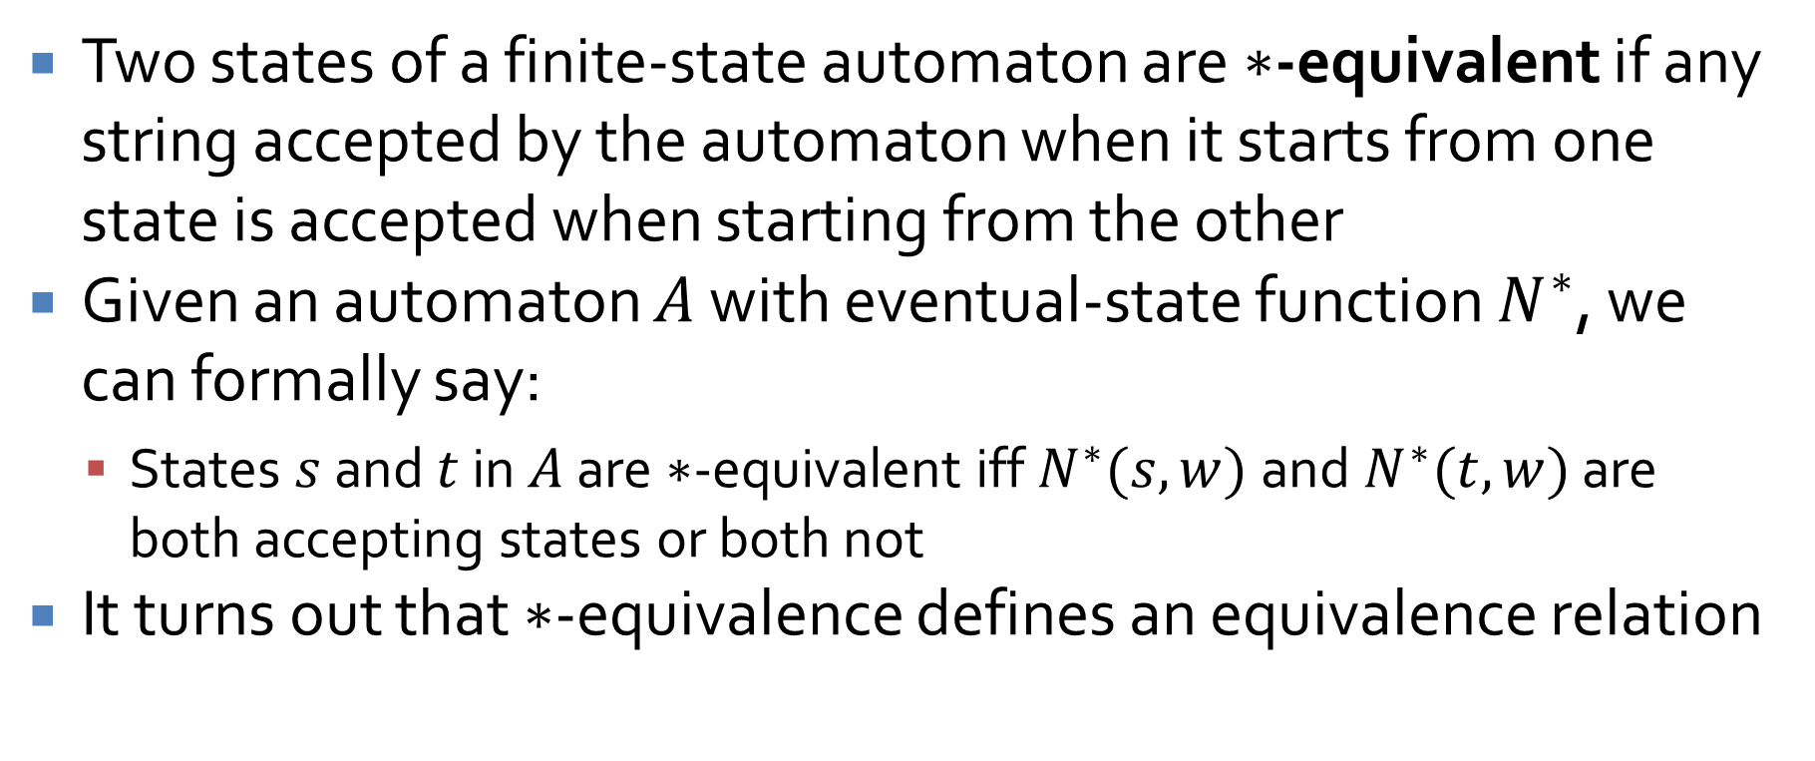
*-equivalence
Two states of a finite-state automaton are $∗$-equivalent if any string accepted by the automaton when it starts from one state is accepted when starting from the other
Given an automaton $A$ with eventual-state function $N^{∗}$, we can formally say:
States $s$ and $t$ in $A$ are $∗$-equivalent iff $N^{∗}(s,w)$ and $N^{∗}(t,w)$ are both accepting states or both not
It turns out that $∗$-equivalence defines an equivalence relation

Slide 8
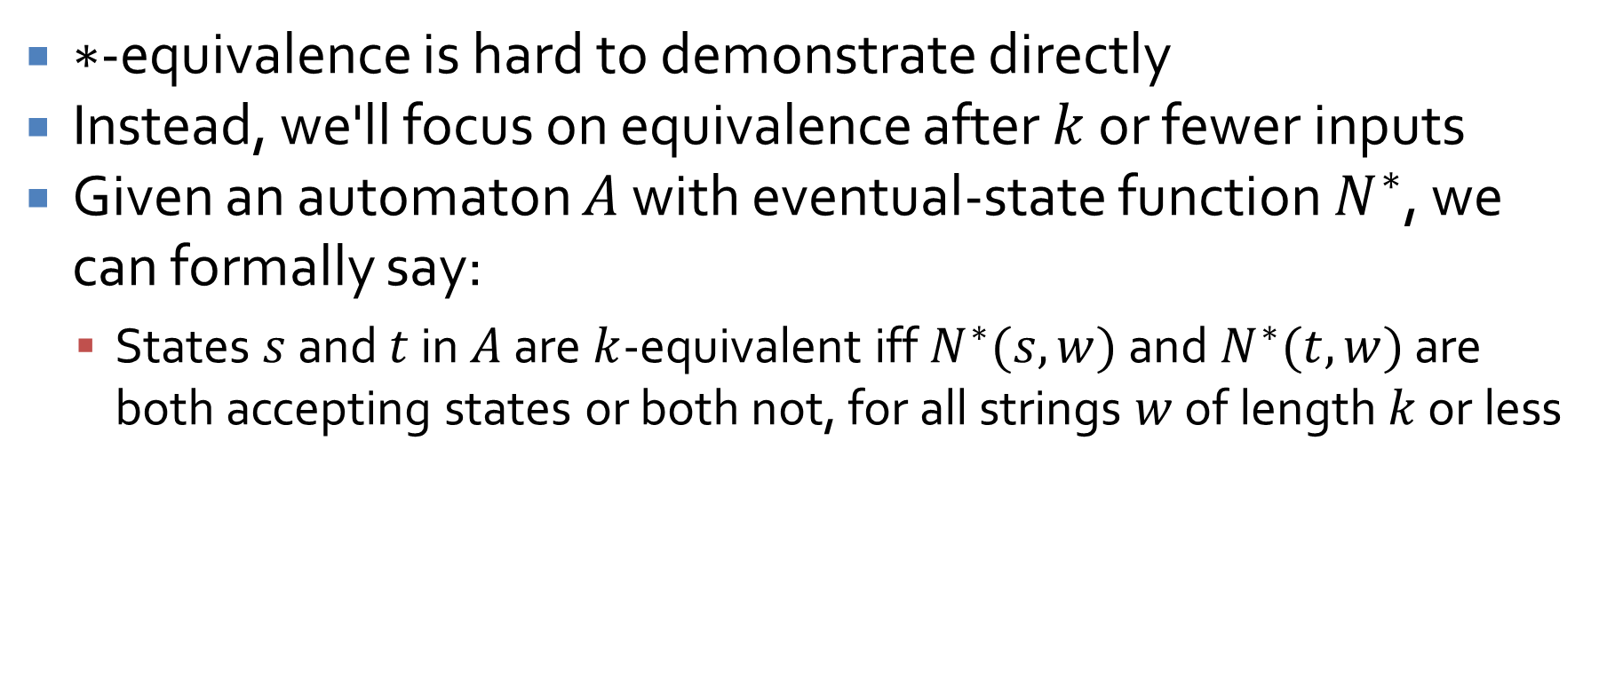
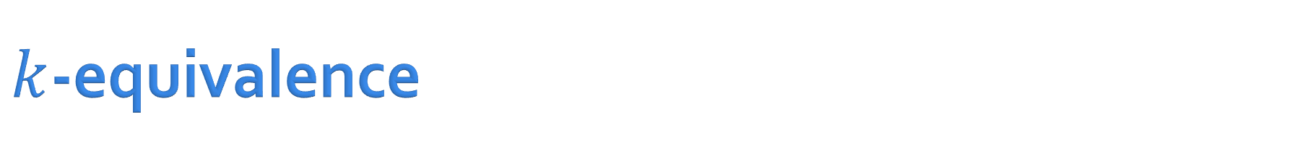
$k$-equivalence
$∗$-equivalence is hard to demonstrate directly
Instead, we'll focus on equivalence after $k$ or fewer inputs
Given an automaton $A$ with eventual-state function $N^{∗}$, we can formally say:
States $s$ and $t$ in $A$ are $k$-equivalent iff $N^{∗}(s,w)$ and $N^{∗}(t,w)$ are both accepting states or both not, for all strings $w$ of length $k$ or less

Slide 9
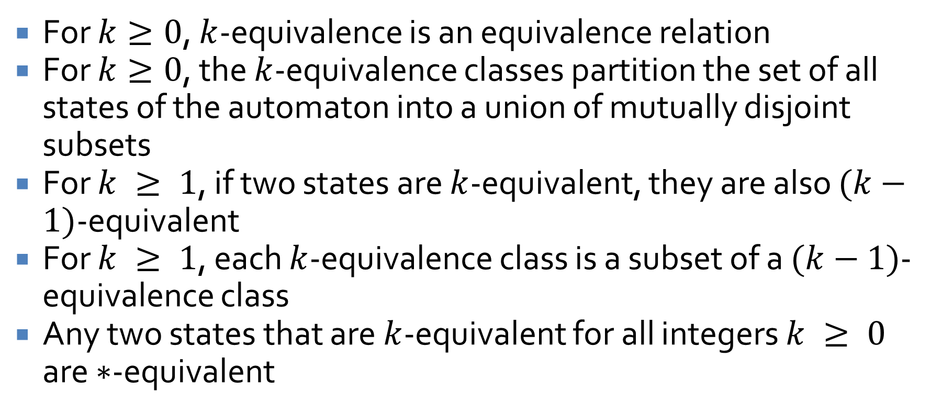
Facts about k-equivalence
For $k≥0$, $k$-equivalence is an equivalence relation
For $k≥0$, the $k$-equivalence classes partition the set of all states of the automaton into a union of mutually disjoint subsets
For $k ≥ 1$, if two states are $k$-equivalent, they are also $(k−1)$-equivalent
For $k ≥ 1$, each $k$-equivalence class is a subset of a $(k−1)$-equivalence class
Any two states that are $k$-equivalent for all integers $k ≥ 0$ are $∗$-equivalent

Slide 10
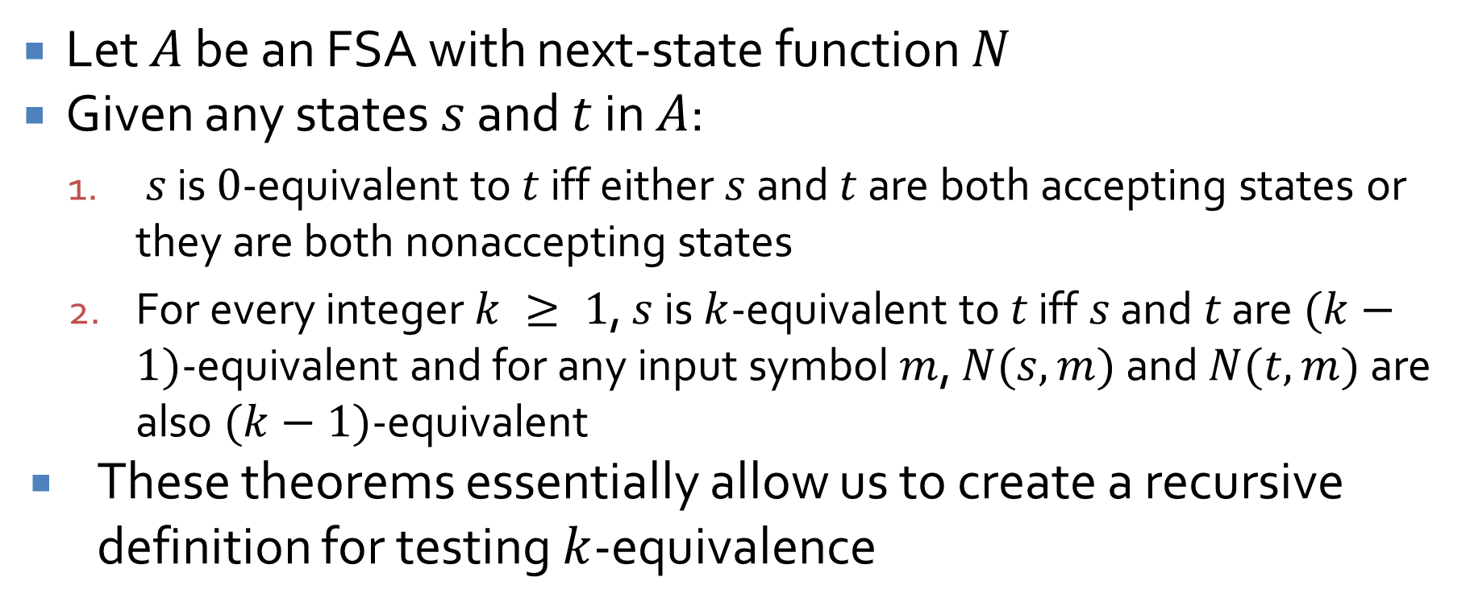
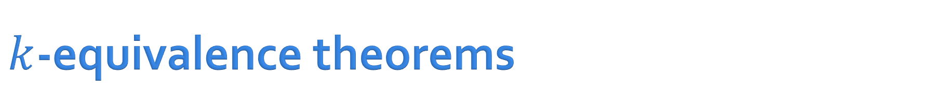
$k$-equivalence theorems
Let $A$ be an FSA with next-state function $N$
Given any states $s$ and $t$ in $A$:
$s$ is $0$-equivalent to $t$ iff either $s$ and $t$ are both accepting states or they are both nonaccepting states
For every integer $k ≥ 1$, $s$ is $k$-equivalent to $t$ iff $s$ and $t$ are $(k−1)$-equivalent and for any input symbol $m$, $N(s,m)$ and $N(t,m)$ are also $(k−1)$-equivalent
These theorems essentially allow us to create a recursive definition for testing $k$-equivalence

Slide 11



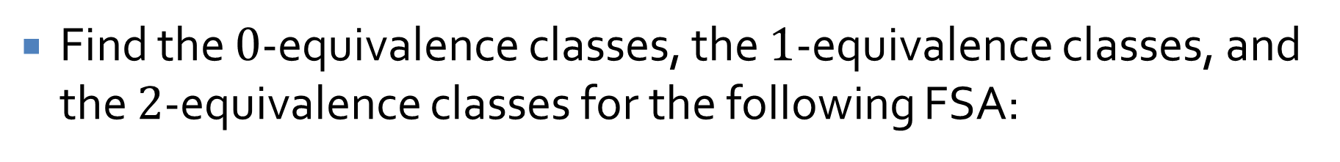



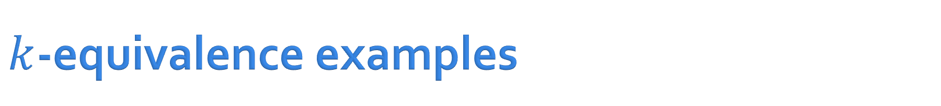









$k$-equivalence examples
Find the $0$-equivalence classes, the $1$-equivalence classes, and the $2$-equivalence classes for the following FSA:
$$1$$
$$s_{0}$$
$$1$$
$$s_{1}$$
$$0$$
$$s_{2}$$
$$0$$
$$1$$
$$1$$
$$1$$
$$0$$
$$0$$
$$s_{4}$$
$$s_{3}$$
$$0$$

Slide 12
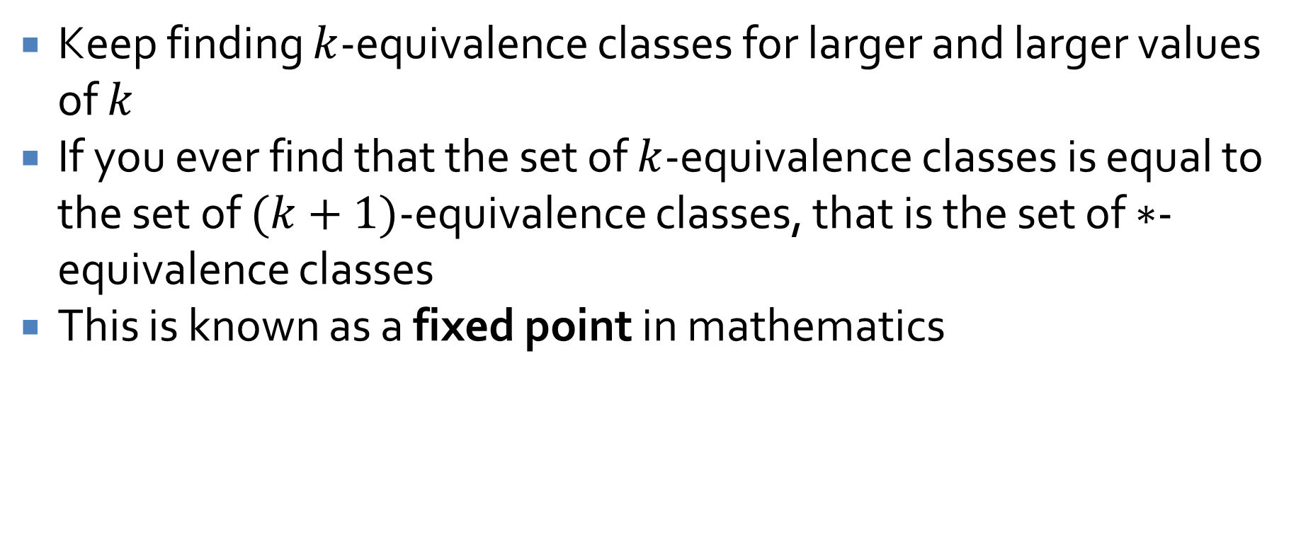

Finding the $∗$-equivalence classes
Keep finding $k$-equivalence classes for larger and larger values of $k$
If you ever find that the set of $k$-equivalence classes is equal to the set of $(k+1)$-equivalence classes, that is the set of $∗$-equivalence classes
This is known as a fixed point in mathematics

Slide 13
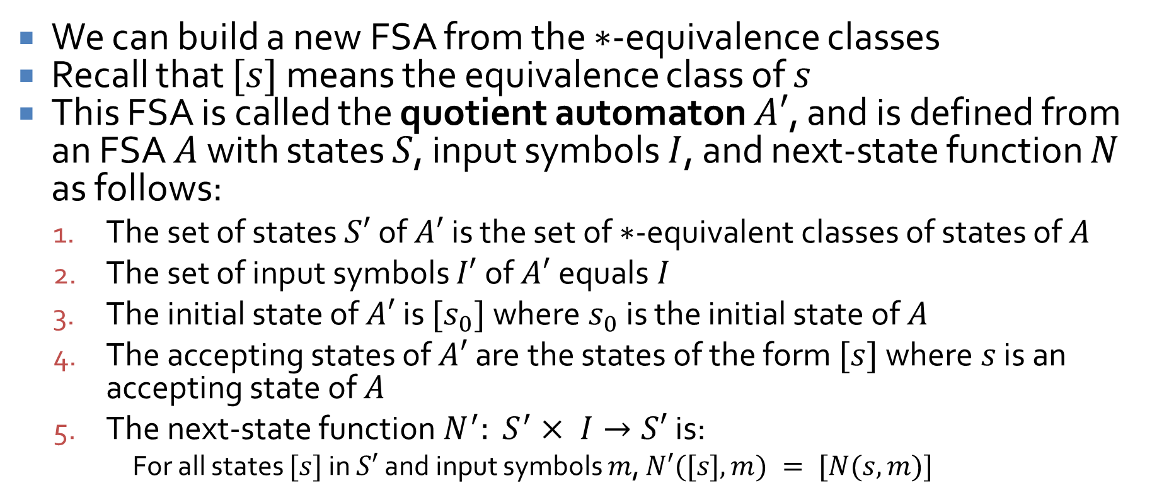
The quotient automaton
We can build a new FSA from the $∗$-equivalence classes
Recall that $[s]$ means the equivalence class of $s$
This FSA is called the quotient automaton $A′$, and is defined from an FSA $A$ with states $S$, input symbols $I$, and next-state function $N$ as follows:
The set of states $S′$ of $A′$ is the set of $∗$-equivalent classes of states of $A$
The set of input symbols $I′$ of $A′$equals $I$
The initial state of $A′$ is $[s_{0}]$ where $s_{0}$ is the initial state of $A$
The accepting states of $A′$ are the states of the form $[s]$ where $s$ is an accepting state of $A$
The next-state function $N^{′}: S^{′}× I→S′$ is:
For all states $[s]$ in $S′$ and input symbols $m$, $N′([s], m) = [N(s,m)]$

Slide 14
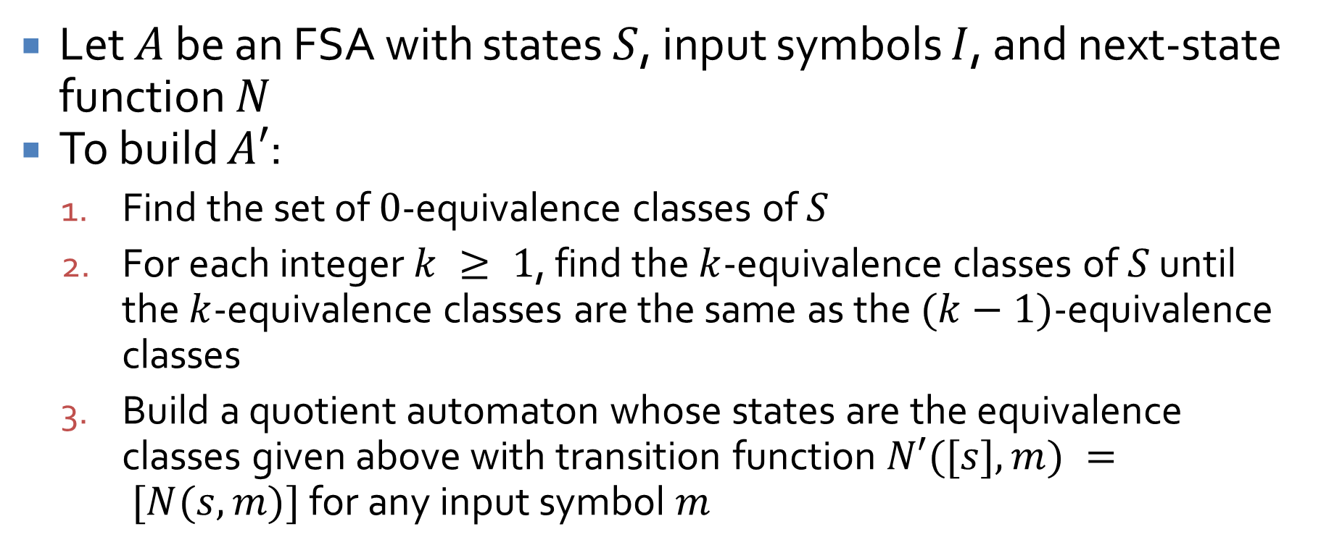
Constructing a quotient automaton
Let $A$ be an FSA with states $S$, input symbols $I$, and next-state function $N$
To build $A′$:
Find the set of $0$-equivalence classes of $S$
For each integer $k ≥ 1$, find the $k$-equivalence classes of $S$ until the $k$-equivalence classes are the same as the $(k−1)$-equivalence classes
Build a quotient automaton whose states are the equivalence classes given above with transition function $N′([s],m) = [N(s,m)]$for any input symbol $m$

Slide 15
Quotient automaton example
Find the quotient automaton for the following FSA
$$1$$
$$s_{0}$$
$$1$$
$$s_{1}$$
$$0$$
$$s_{2}$$
$$0$$
$$1$$
$$1$$
$$1$$
$$0$$
$$0$$
$$s_{4}$$
$$s_{3}$$
$$0$$

Slide 16
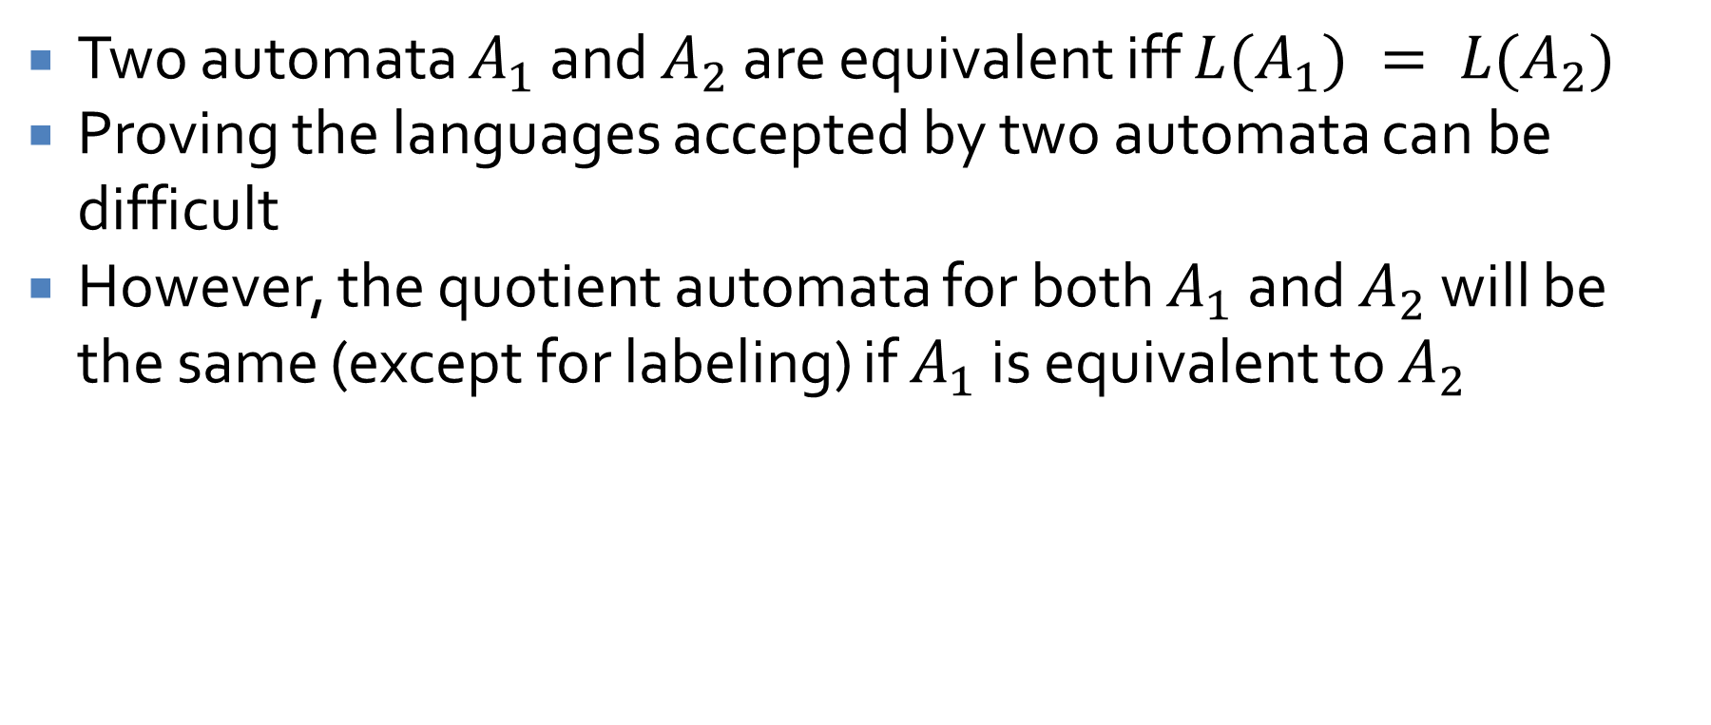
Equivalent automata
Two automata $A_{1}$ and $A_{2}$ are equivalent iff $L(A_{1}) = L(A_{2})$
Proving the languages accepted by two automata can be difficult
However, the quotient automata for both $A_{1}$ and $A_{2}$ will be the same (except for labeling) if $A_{1}$ is equivalent to $A_{2}$

Slide 17





















Proving equivalence
Prove that the following two automata are equivalent by finding their quotient automata
$$s_{2}$$
$$s_{1}′$$
$$0$$
$$0, 1$$
$$1$$
$$1$$
$$0$$
$$0$$
$$1$$
$$1$$
$$s_{0}$$
$$s_{1}$$
$$s_{0}′$$
$$s_{2}′$$
$$0$$
$$0$$
$$0$$
$$1$$
$$1$$
$$s_{3}$$
$$1$$
$$s_{3}′$$
$$0$$

Slide 18
Context-Free Grammars
Three-Sentence Summary

Slide 19
Context Free Languages

Slide 20
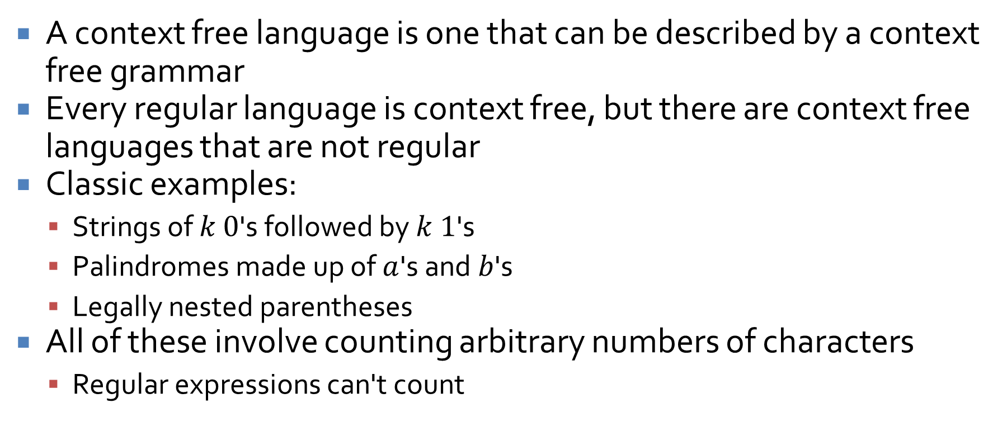
Context free languages
A context free language is one that can be described by a context free grammar
Every regular language is context free, but there are context free languages that are not regular
Classic examples:
Strings of $k$ $0$'s followed by $k$ $1$'s
Palindromes made up of $a$'s and $b$'s
Legally nested parentheses
All of these involve counting arbitrary numbers of characters
Regular expressions can't count

Slide 21
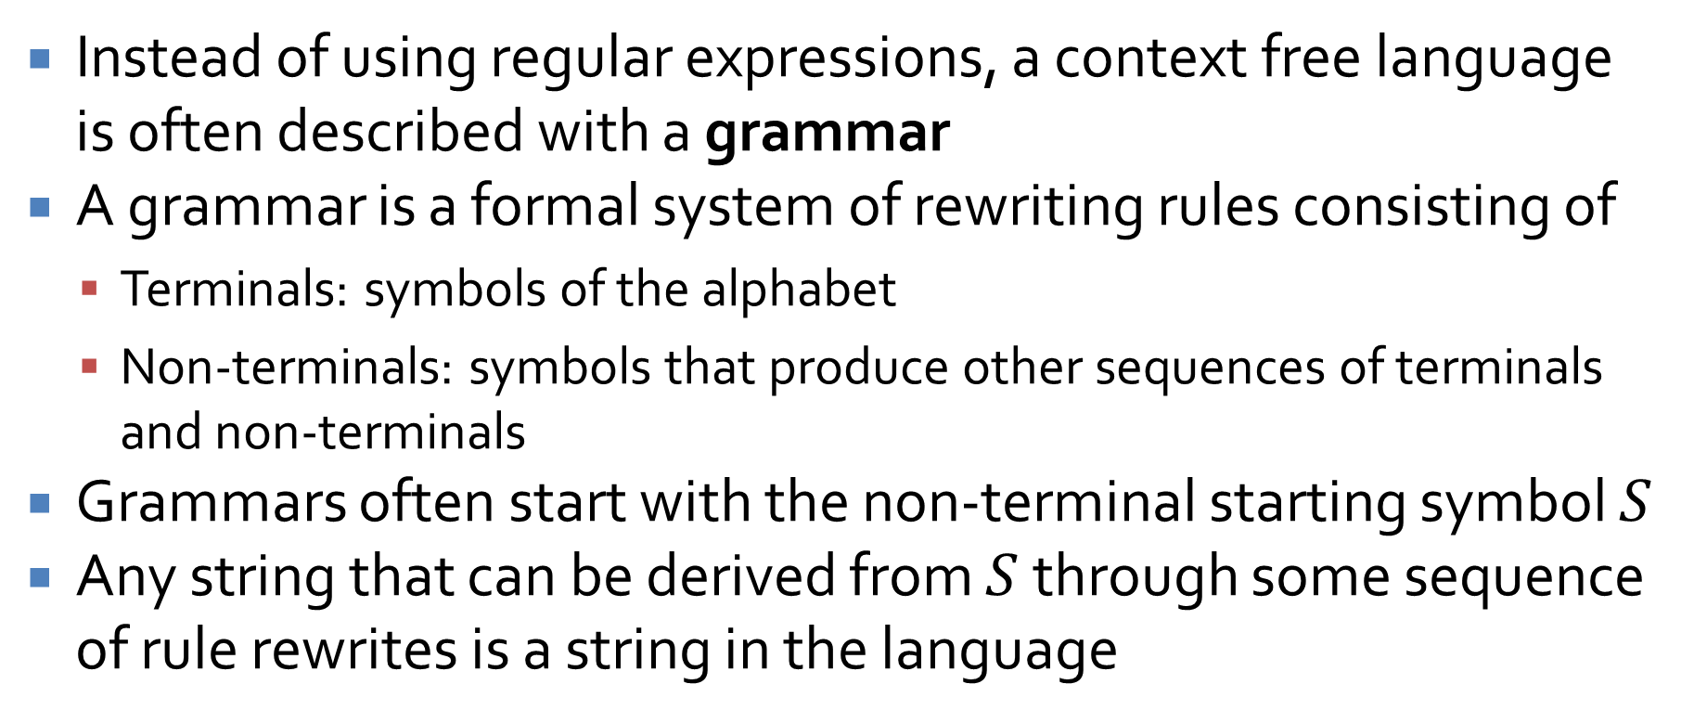
Context free grammars
Instead of using regular expressions, a context free language is often described with a grammar
A grammar is a formal system of rewriting rules consisting of
Terminals: symbols of the alphabet
Non-terminals: symbols that produce other sequences of terminals and non-terminals
Grammars often start with the non-terminal starting symbol $S$
Any string that can be derived from $S$ through some sequence of rule rewrites is a string in the language

Slide 22
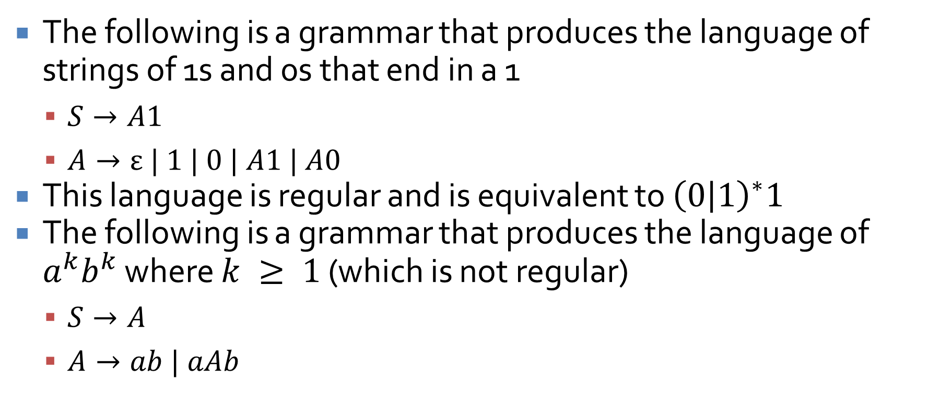
Simple context free grammars
The following is a grammar that produces the language of strings of 1s and 0s that end in a 1
$S→A1$
$A→ε | 1 | 0 | A1 | A0$
This language is regular and is equivalent to ${\left(0 | 1\right)}^{∗}1$
The following is a grammar that produces the language of $a^{k}b^{k}$ where $k ≥ 1$ (which is not regular)
$S→A$
$A→ab | aAb$

Slide 23
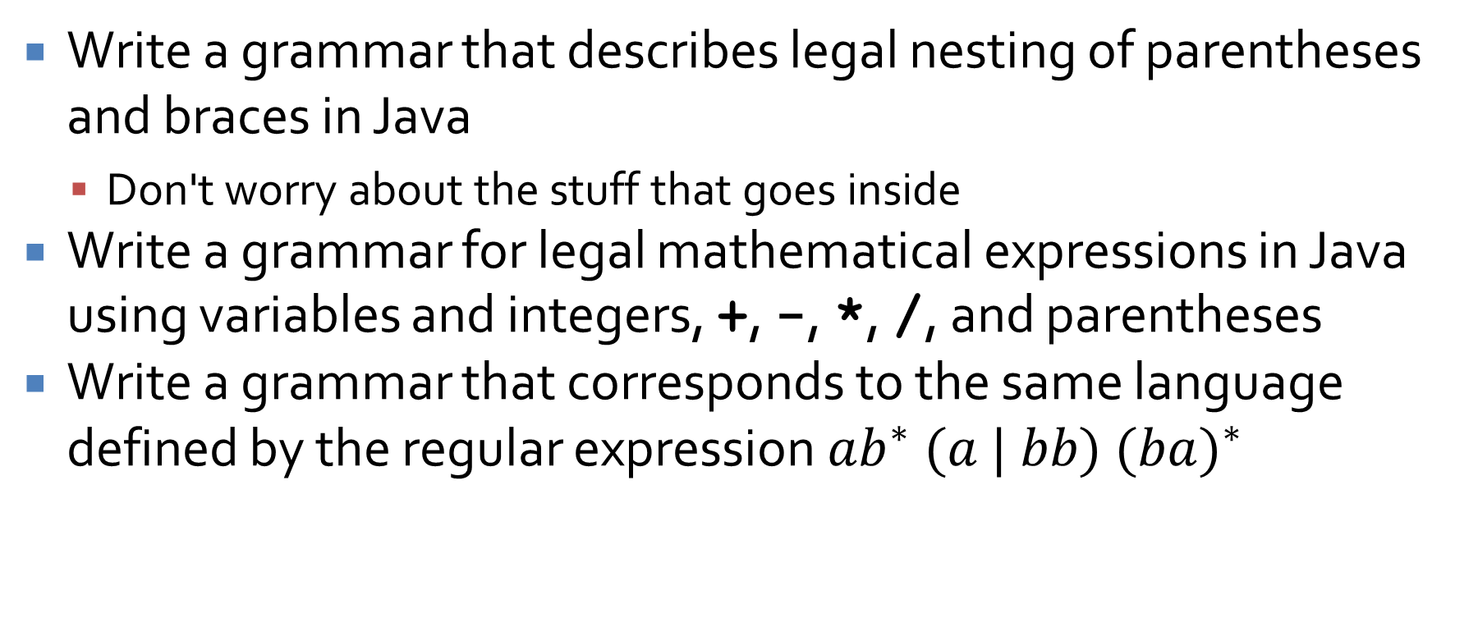
CFG examples
Write a grammar that describes legal nesting of parentheses and braces in Java
Don't worry about the stuff that goes inside
Write a grammar for legal mathematical expressions in Java using variables and integers, +, -, *, /, and parentheses
Write a grammar that corresponds to the same language defined by the regular expression $ab^{∗} (a | bb) (b{a)}^{∗}$

Slide 24
Upcoming

Slide 25
Next time…
Pushdown automata
Turing machines and the halting problem

Slide 26
Reminders
Keep working on Assignment 6

